Slide 1

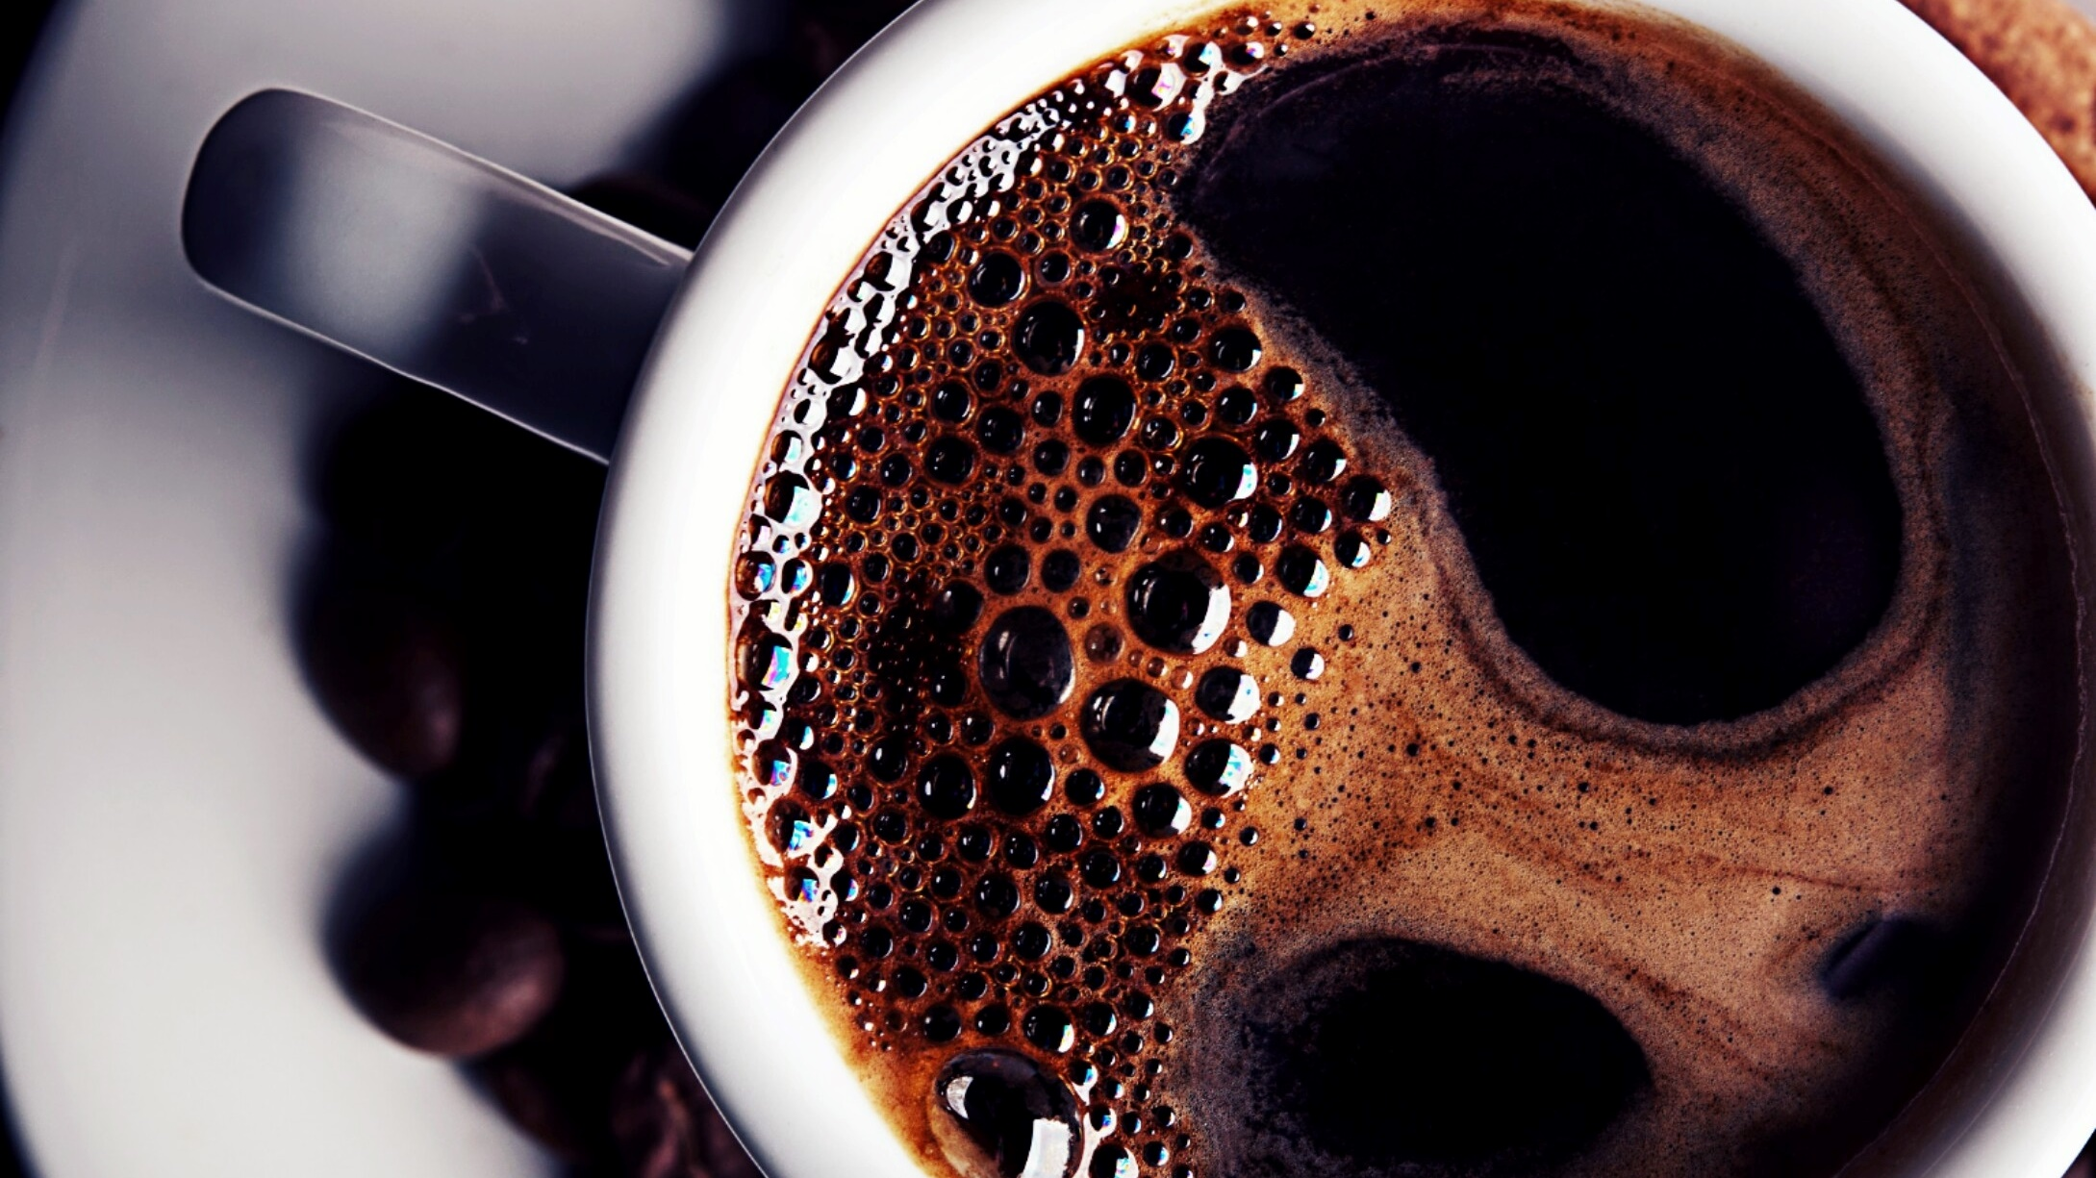
Data Structure and Algorithm in C++
Syed Syab Ahmad Shah
BS Software Engineering
At University of SWAT

Slide 2
Course and Details
This course is for any one
01
Working
02
Implementation of Data structure and algorithm in the form of C++ program
03

Slide 3
Data Structure and Algorithm in C++
Data Structure
A data structure is a named location that can be used to store and organize data.
There are two fundamental kinds of data structures:
array of contiguous memory locations and
linked structures.

Slide 4
Data Structure and Algorithm in C++
Algorithm
An algorithm is a collection of steps to solve a particular problem.
An algorithm is a procedure or formula for solving a problem, based on conducting a sequence of specified actions. A computer program can be viewed as an elaborate algorithm. In mathematics and computer science, an algorithm usually means a small procedure that solves a recurrent problem.

Slide 5
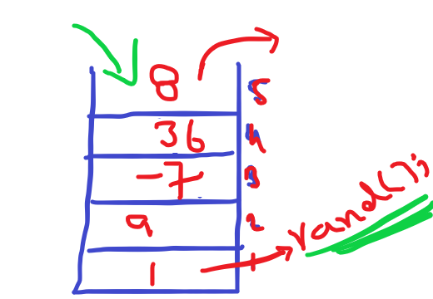
Data Structure and Algorithm in C++
Stack Data Structure
Stack is an ordered list of similar data
type. Stack is a LIFO(Last in First out)
structure or we can,
say FILO(First in Last out).
Both insertion and removal,
are allowed at only one end of Stack,
called Top.

Slide 6
Data Structure and Algorithm in C++
Stack Data Structure
Items are added on top of the stack called push Operation.
Items are remove on top of the stack called
pop Operation.

Slide 7
Data Structure and Algorithm in C++
Standers Stack Operation
Push();
Pop();
isEmpty();
Isfull();

Slide 8
Data Structure and Algorithm in C++
Standers Stack Operation
Peek();
Count();
Change();
Display();

Slide 9
Data Structure and Algorithm in C++
Some Applications of Stack Data Structure –
Balancing of symbols
Infix to Postfix /Prefix conversion
Redo-undo features at many places like editors, photoshop.
Forward and backward feature in web browsers
Used in many algorithms like Tower of Hanoi, tree traversals, stock span problem, histogram problem.
Other applications can be Backtracking, Knight tour problem, rat in a maze, N queen problem and sudoku solver
In Graph Algorithms like Topological Sorting and Strongly Connected Components

Slide 10
Data Structure and Algorithm in C++
Link TO the Source Code.

